Slide 1
Genetic Algorithm

Slide 2

Let us look at a problem
I_LOVE_PYTHON
_

Slide 3
First step towards genetic algorithm (Generate Population)
TSLSAEDP__STED
SWESA_DPRQ_RQS
O E LPVE IPYTHON
_
ESDGADSFAT_G_

Slide 4
FITNESS FUNCTION
A Fitness Score is given to each individual which shows the ability of an individual to “compete”. The individual having optimal fitness score (or near optimal) are sought.
5
O E LPVE IPYTHON
I_LOVE_PYTHON
13
SWESA_DPRQ_RQS
I_LOVE_PYTHON

Slide 5
PARENT SELECTION AND CROSSOVER
TSLSAEDP__STED
O E LPVE IEYRGON
O E LPVDP__STED
SWESA_DPRQ_RQS
TSLSAEDP__STED
TSLSAEIEYRGON
O E LPVE IEYRGON
S_ESA_DPPY_RQS
S_ESA_DPPY_TED
S_ESA_DPPY_RQS
TSLSAEDP__STED
TSLSAEDP__SRQS

Slide 6
MUTATION
O E LPVDP__STED
O E LPVDP__STOD

Slide 7

Parent Selection
Crossover
Mutation

Slide 8
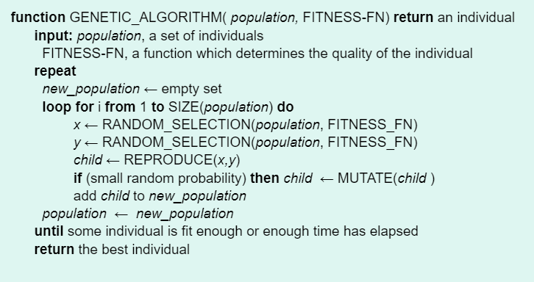
Algorithm

